Slide 1

Emotion Classification using EEG Signals
EEL 781 - Project
Supervisor
Dr. Jayadeva
Teaching Assistant
Sumit Soman
G. Nitesh Bharadwaj
2011EE20514
Nipun Shrivastava
2011CS50288
Notes:
Hello. We are here today to present on the topic Emotion Classification using EEG signals. We chose this topic because Emotion recognition by computers is becoming increasingly popular and it has many interesting applications like virtual reality, gaming, remote communication etc.

Slide 2
Objective
To discriminate emotions in the valence, arousal, dominance and liking dimensions
The project is broken down to few steps:
Preprocessing Data
Feature Extraction
Feature Selection
Learning
Prediction & Verification
Notes:
Starting of with the objective, in this project we have tried to devise and analyses different learning models to discriminate emotions into high/low valence, arousal, dominance and liking. Many different emotions like anger, disgust, fear, joy etc. can be plotted in these four dimensions. The major components of our project are:

Slide 3
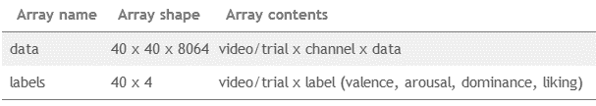
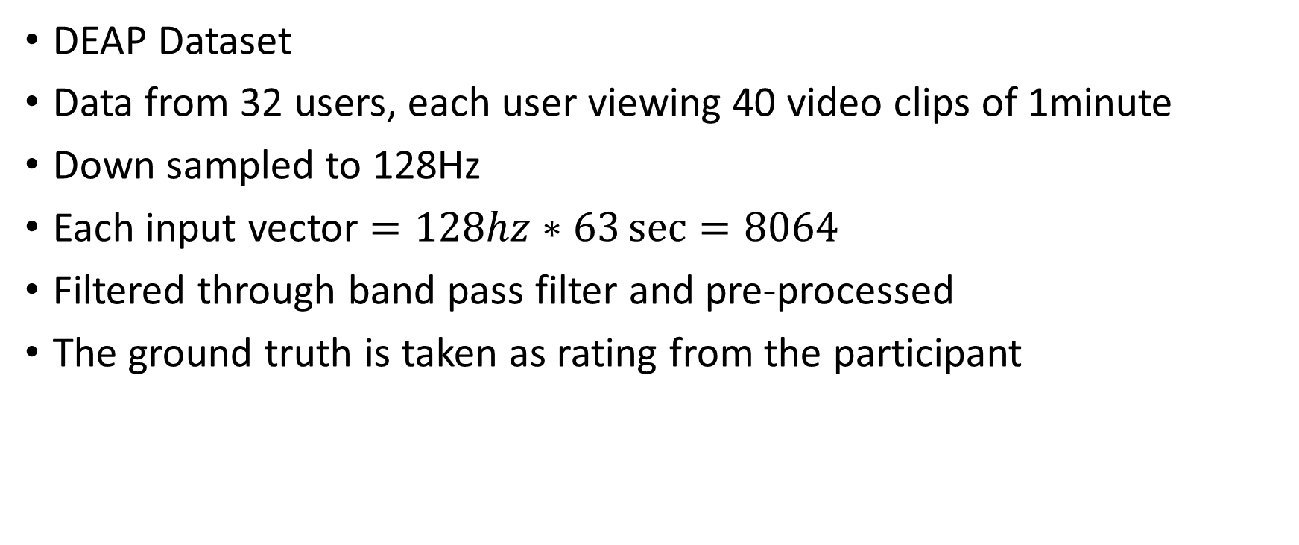
Dataset Description
DEAP Dataset
Data from 32 users, each user viewing 40 video clips of 1minute
Down sampled to 128Hz
Each input vector $=128hz∗63\sec{=8064}$
Filtered through band pass filter and pre-processed
The ground truth is taken as rating from the participant
Notes:
For our project we have used DEAP dataset which is the preprocessed EEG data collected for 32 different persons watching 40 different videos collected over a period of 63 seconds at the rate of 128hz. At the end of the video the subjects were asked to provide their feedback on the valence, arousal, liking and dominance domain which was then converted to proper scale and included in DEAP dataset as labels.

Slide 4
Feature Extraction
Apart from 32 given channels, 61 virtual channels are constructed
PSD
Common feature in papers [2], [3] and [4]
The power spectral density is calculated using pwelch function in MATLAB with a hamming window of 2 seconds with a 50 percent overlap.
The area under PSD v/s frequency curve gives the spectral power.
Calculated for delta, alpha, beta and gamma bands
Cross Spectrum Features
Magnitude Squared Coherence Features
Capture interactions between different regions of the brain
Notes:
Coming to Feature Extraction. We took the EEG data and performed Longitudinal and Transverse Bipolar montage. The difference between two corresponding channels of EEG was calculated . The corresponding channels are taken from paper.
PSD, MSCE

Slide 5
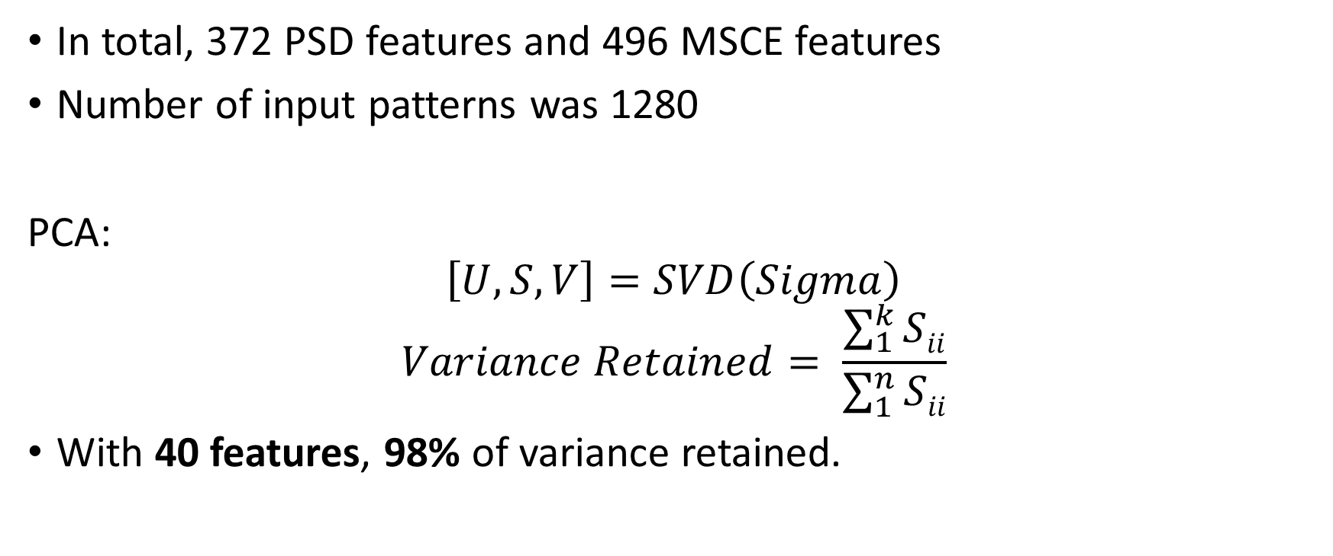
Feature Extraction and Selection
In total, 372 PSD features and 496 MSCE features
Number of input patterns was 1280
PCA:
$$\left[U,S,V\right]=SVD\left(Sigma\right)$$
$$Variance Retained= \frac{\sum_{1}^{k}{Sii}}{\sum_{1}^{n}{Sii}}$$
With 40 features, 98% of variance retained.
Notes:
Since, there were a lot of features and only a few data points we were continuously suffering from the problem of over fitting. Therefore we decided to reduce the number of features using PCA by taking the top 40 Eigen vectors. 40 was chosen by thresholding the retained variance at 98%. The variance retained can be directly calculated using the trace values of the S matrix obtained from applying SVD on Cross correlation matrix of X

Slide 6
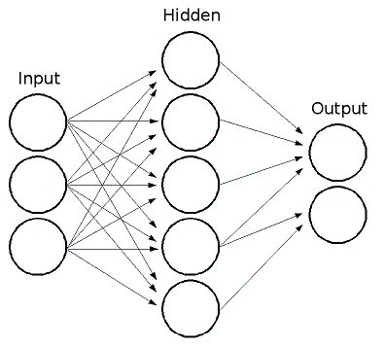
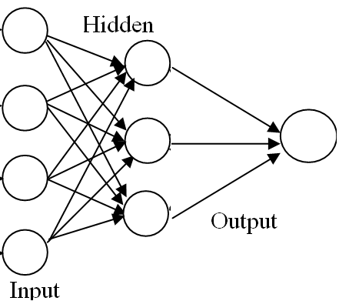
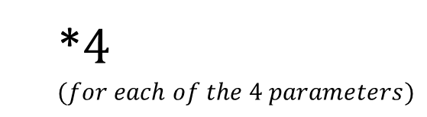
Learning – Neural Network
A simple 2 layer feed forward network
Error back propagation is implemented in MATLAB
Varying the number of hidden layer neurons
Learning all four classes simultaneously v/s individually
*$4$
$$(for each of the 4 parameters)$$
Simultaneous Model
Individual Model
Notes:
The first model that we used was that of neural network. There were two types of networks that we implemented- one with 4 output units and other with 4 network with one output unit corresponding to 4 parameters. The accuracy that we obtained from simultaneous model was very low suggesting that the 4 parameters that we wanted to predict were completely independent from each other and therefore reduced the each other’s accuracy by negatively affecting the weight vectors. Therefore, we switched to the architecture of 4 independent network with single output unit to be used as the predictor. Neural network performed relatively well as the accuracy jumped to 64 percent for best case scenario.

Slide 7
Learning c-SVM and Logistic Regression
c-SVM
Using LibSVM
Tested using RBF Kernel
Changing gamma and c values – Coordinate Descent
Cross validation using 10 trials
Logistic Regression
A logistic classifier was implemented in MATLAB
Theta values were evaluated
Different stopping criteria were used to get best accuracy
Notes:
The other 2 models that we used were SVM with RBF kernel and logistic regression with gradient descent. SVM models can be altered by changing the gamma and cost value that affects the rate of change and misclassification penalty while logistic regression can be altered by changing the learning rate and stopping criteria threshold. Though in case of logistic regression not much will change in theta value for small changes in learning rate or threshold.
The optimum value of gamma and C for SVM was calculated using coordinate descent on the two with accuracy as the optimizing function.
We performed cross validating 10 different times to get a good estimate of accuracy for each hypothesis for the model.

Slide 8
Prediction and Verification
Cross Validation:
Randomly separate patterns into training and test sets in a ratio of 4:1
Train on the training set, test on test set
Repeat for n trials
Report mean and standard deviation of accuracy
Notes:
As mentioned earlier we used cross validation for analysis different models performance on the Deap dataset. Cross validation helped us to find the estimate of the generalized error which is what a good learning machine should minimize. For cross validation we first randomly divided the data set into training and test in the ratio of 4:1. We trained our models with the training set and then performed the accuracy test on the test set. Doing this also helped us from producing vague results under overfitting as the RBF for some values of gamma and C gave an accuracy of 100% when tested on the data set it was trained on.
The training and testing was performed multiple times in order to get the best estimate of average accuracy and standard deviation of the models.

Slide 9
Classification Method | Valence | Arousal | Dominance | Liking
C-SVM | 56% ± 2.9% | 59% ± 2.9% | 64% ± 2.7% | 67% ± 2%
C-SVM with MSCE | 63% ± 2% | 62% ± 2% | 65% ± 2.5% | 67% ± 2.7%
Error Back propagation | 56% ± 0.2 | 54.3% ± 7.7% | 62% ± 0.8% | 60% ± 4.4%
Error Back Propagation with MSCE | 57% ± 2.7% | 58% ± 0.3% | 62% ± 0.8% | 60% ± 0.5%
Logistic regression | 50% ± 5% | 48% ± 7% | 48% ± 7% | 44% ± 11%
Logistic regression with MSCE | 58% ± 3.3% | 59% ± 3.1% | 63% ± 1.7% | 68% ± 2.8%
Final Results
Notes:
Here is the table showing how well implementations performed on the deap dataset. We used 3 models as discussed earlier. In this table we have included the results for all the models with PSD and then with MSCE features. The standard deviation that we got when we dealt with MSCE features were far smaller than the models trained with PSD. Suggesting us that MCSE features were a better choice for feature vectors to be used for prediction.

Slide 10
Notes:
Again here we can see that the bars for the models trained with MSCE features are longer than the ones with PSD features further enforcing the fact that MSCE features are the better predictor of emotions in humans.

Slide 11
Problems and Analysis
Non Linearity:
Using linear SVM and regression the accuracy was very low.
This suggests non linear dependencies
Use RBF Kernels
Over fitting:
Initially, accuracy was 55% with training accuracy of 99%
This, along with features/patterns ratio is indicative of over-fitting
PCA was used
Interaction between brain regions:
Using virtual channels
Using MSCE Features
Notes:
From the various tests that we performed, we were able to conclude three main points. First one being the non linear nature of the data. Since a linear svm and logistic classifier performed the worst on the given dataset among all models with accurately close to 54% with MSCE features and less than 50% for PSD, we can easily infer that the data wasn’t linearly separable. The result that we were able to conclude was the model suffered from overfitting. This was due to the fact that we had huge number of features but very less number of data points. So inorder to reduce the extent of overfitting we used PCA that reduced the number of features to 40 while retaining 98% of the actual variance. Our final analysis was on the better predictor of human emotions. All the models performed relatively well when trained with MSCE features suggesting us that psd features are relatively bad at predicting emotions for humans than MSCE features.

Slide 12
Training on Per Person Basis
Classification Method | Valence | Arousal | Dominance | Liking
C-SVM with MSCE | 57% ± 13% | 47% ± 14.9% | 63% ± 14.5% | 86% ± 9%
Error Back Propagation with MSCE | 52% ± 11% | 49% ± 8% | 59% ± 13% | 85% ± 7.5%
Logistic regression with MSCE | 53.5% ± 16% | 59.5% ± 16% | 69.5% ± 17% | 91.5% ± 5.5%
Average Result
Notes:
Since, the EEG data value for the same video and labels varied greatly among different persons, we decided to make person specific learners. The accuracy jumped for dominance and liking greatly when we performed this.

Slide 13
Notes:
The chart here shows the accuracy for a person specific model for Valence.

Slide 14
Notes:
This chart displays the results for the liking parameter when person specific models were used.

Slide 15
Conclusions and Future Works
Emotions aren't linear functions of spectral features.
No cross correlation between the 4 labels
C-SVM performed the best
Accuracy comparable to referenced papers
C-SVM implementations in [1], [2] have accuracies less than 60% while ours was around 64%. This is due to the addition of MSCE features
The Bayesian log-posterior network in [2] boasts accuracy of 70% while they using only psd features.
Better idea to have person specific learner
Notes:
The final conclusions from this project are: first of all emotions do not share a linear relation ship with spectral features of EEG data as the linear models were worst off at predicting the emotions during the course of project. Using single neural network generated very low accuracy suggesting us that the 4 parameters that we want to predict were completely independent of each other. Due to the adaptability and tweaking possibilities of the C-SVM, it came out to be the best predictor for emotions. An average accuracy of 64 was achieved across the 4 parameters when we used MSCE features. Even the paper that we reference gave an accuracy of 60% with c-svm when they used it with their extracted features.
The final and the most important conclusion that we drew from the project was that a person specific learner is much better idea for emotion recognition as the data varied by orders of magnitude across persons in similar emotional state but were consistent for a single person. The heightened accuracy of liking is a huge positive in this direction.
THANK YOU

Slide 16
Notes:
At the end we have compared our approach to the other approaches implemented on the papers that we have cited, clearly ours was only outperformed by the log posterior based method. But the thing to notice here is that when they ran the extracted features on a normal SVM, our method outperformed theirs. Thank You.

